Slide 1

Competitive Programming From Problem 2 Solution in O(1)
P
T
H
I
N
K
F
A
S
T
S
C++: Practice – Loops
Mostafa Saad Ibrahim
Teaching Assistant @ Cairo University

Slide 2
Problem 1
In range 1-100, count how many numbers that has following property
Either number is divisbe by 4
Or divisible by both 6 and 10
We need to check every number = loop
Think, we need variable to pass over numbers in range [1-100] = loop over a variable

Slide 3
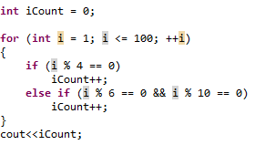
Problem 1 - Solution
Challenge: Could we compute answer mathematically NOT programetically?

Slide 4
Problem 2
Find How many X, Y numbers such that
X in range [1-100]
Y in range [70-200]
X < Y
(X+Y) divisble by 7
So we need to try all Xs and all Ys?
One loop iterate on X and other on Y

Slide 5
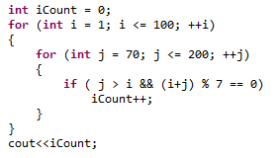
Problem 2 - Solution

Slide 6
Problem 2 – Solution - Analysis
Notice that
When E.g. i = 90
All j tried from 70-90 will never be counted
As j <= i
Could we change code to don’t do useless operations?

Slide 7
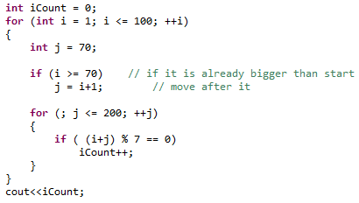
Problem 2 – Solution – V2

Slide 8
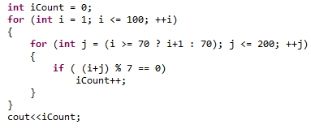
Problem 2 – Solution – V3

Slide 9
Problem 3
Find Count of 4 numbers A, B, C and D such that:
0 <= A, B, C, D < 100
I.e. Each number in this range
A+B+C+D = 100
Again, we have 4 variables, each with range. We need loop for each one.

Slide 10
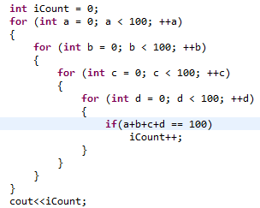
Problem 3 - Solution

Slide 11
Problem 3 – Solution - Analysis
How many operations does this code perfrom?
100 x 100 x 100 x 100 = 100 Million Operations
What if limit is 1000 not 100?
1000 Milliar Operations!!!!!
Does it matte?
Sure, CPU will do processing.
Too many operations = Slow Code
Could we do better?
Can we eliminate one of the loops?

Slide 12
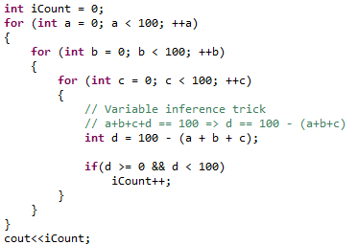
Problem 3 – Solution - Optimized

Slide 13
Better Code?
If we have 2 codes to do same task, which one is better for a CPU?
CPU has 2 conerns:
Allocated memory and Number of operations
“Complexity of Algorithms” is the area caring with this conern
Remmeber to think in writting a better code
Faster + Less Memory

Slide 14
Algorithm vs Program
Algorithm: step-by-step procedure to solve a specific problem
Let say we have problem P
When we sketch a solution => We have algorithm
When we code the solution => We have the program

Slide 15
Competition Algorithms vs Courses Algorithms
Courses Algorithms
Problems solution typically easy to sketch
Think In Calculator Example / Hospital application
Typically it is direct requirements translation
Competitions Algorithms
They need too much thinking. Think in last code
They are not direct. Find efficiently divisors of N
They highly care with algorithm # operations & needed memory

